Slide 1
Creation
Please enable editing then view as slideshow in order to listen to audio synchronised with slides.

Slide 2
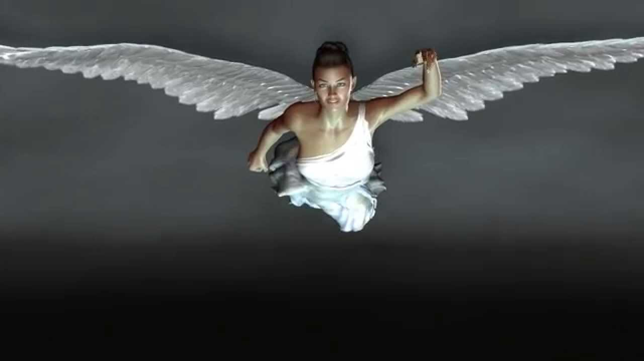
‘Then I saw another angel flying in the midst of heaven, having the everlasting gospel to preach to those who dwell on the earth-- to every nation, tribe, tongue, and people saying with a loud voice,
"Fear God and give glory to Him, for the hour of His judgment has come; and worship Him who made heaven and earth, the sea and springs of water.’ (Rev. 14:6-7 NKJ)

Slide 3
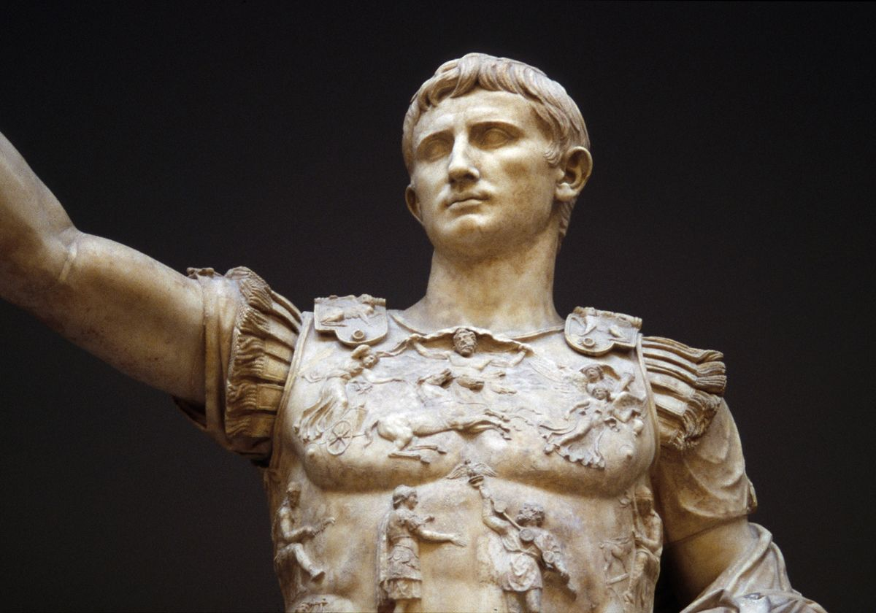
1st CENTURY

Slide 4
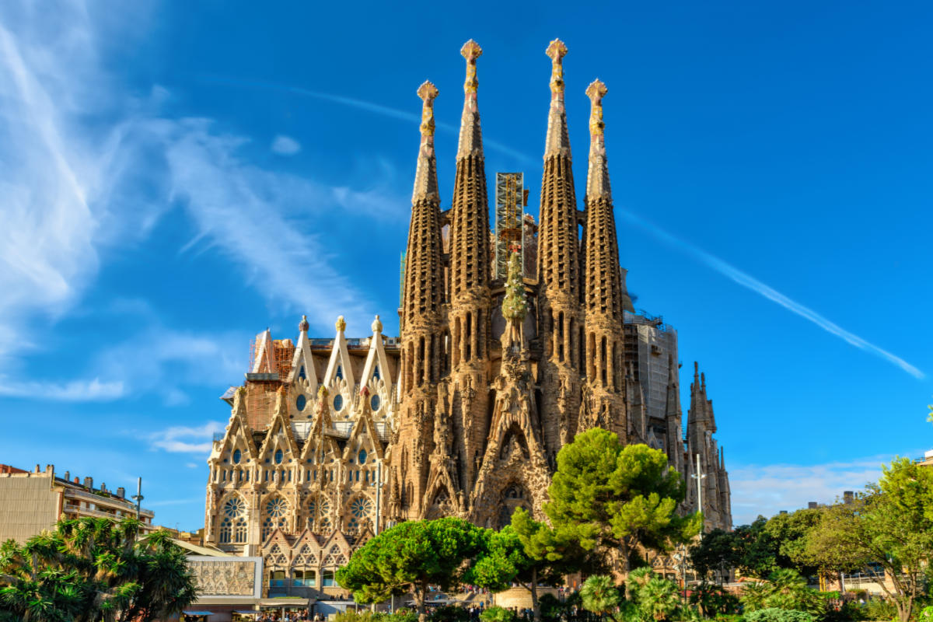
MIDDLE AGES - KINGDOM ON EARTH

Slide 5
MODERN TIMES
The natural seasonal cycle of work and rest replaced by the never-ceasing production

Slide 6
‘So God created man in His own image; in the image of God He created him; male and female He created them…
…And God said, "See, I have given you every herb that yields seed which is on the face of all the earth, and every tree whose fruit yields seed; to you it shall be for food…
…Then God saw everything that He had made, and indeed it was very good. So the evening and the morning were the sixth day…
…Then God blessed the seventh day and sanctified it, because in it He rested from all His work which God had created and made…
...And the LORD God formed man of the dust of the ground, and breathed into his nostrils the breath of life; and man became a living being. The LORD God planted a garden eastward in Eden, and there He put the man whom He had formed…
…Then the LORD God took the man and put him in the garden of Eden to tend and keep it. (Gen. 1:27-2:15 NKJ)

Slide 7
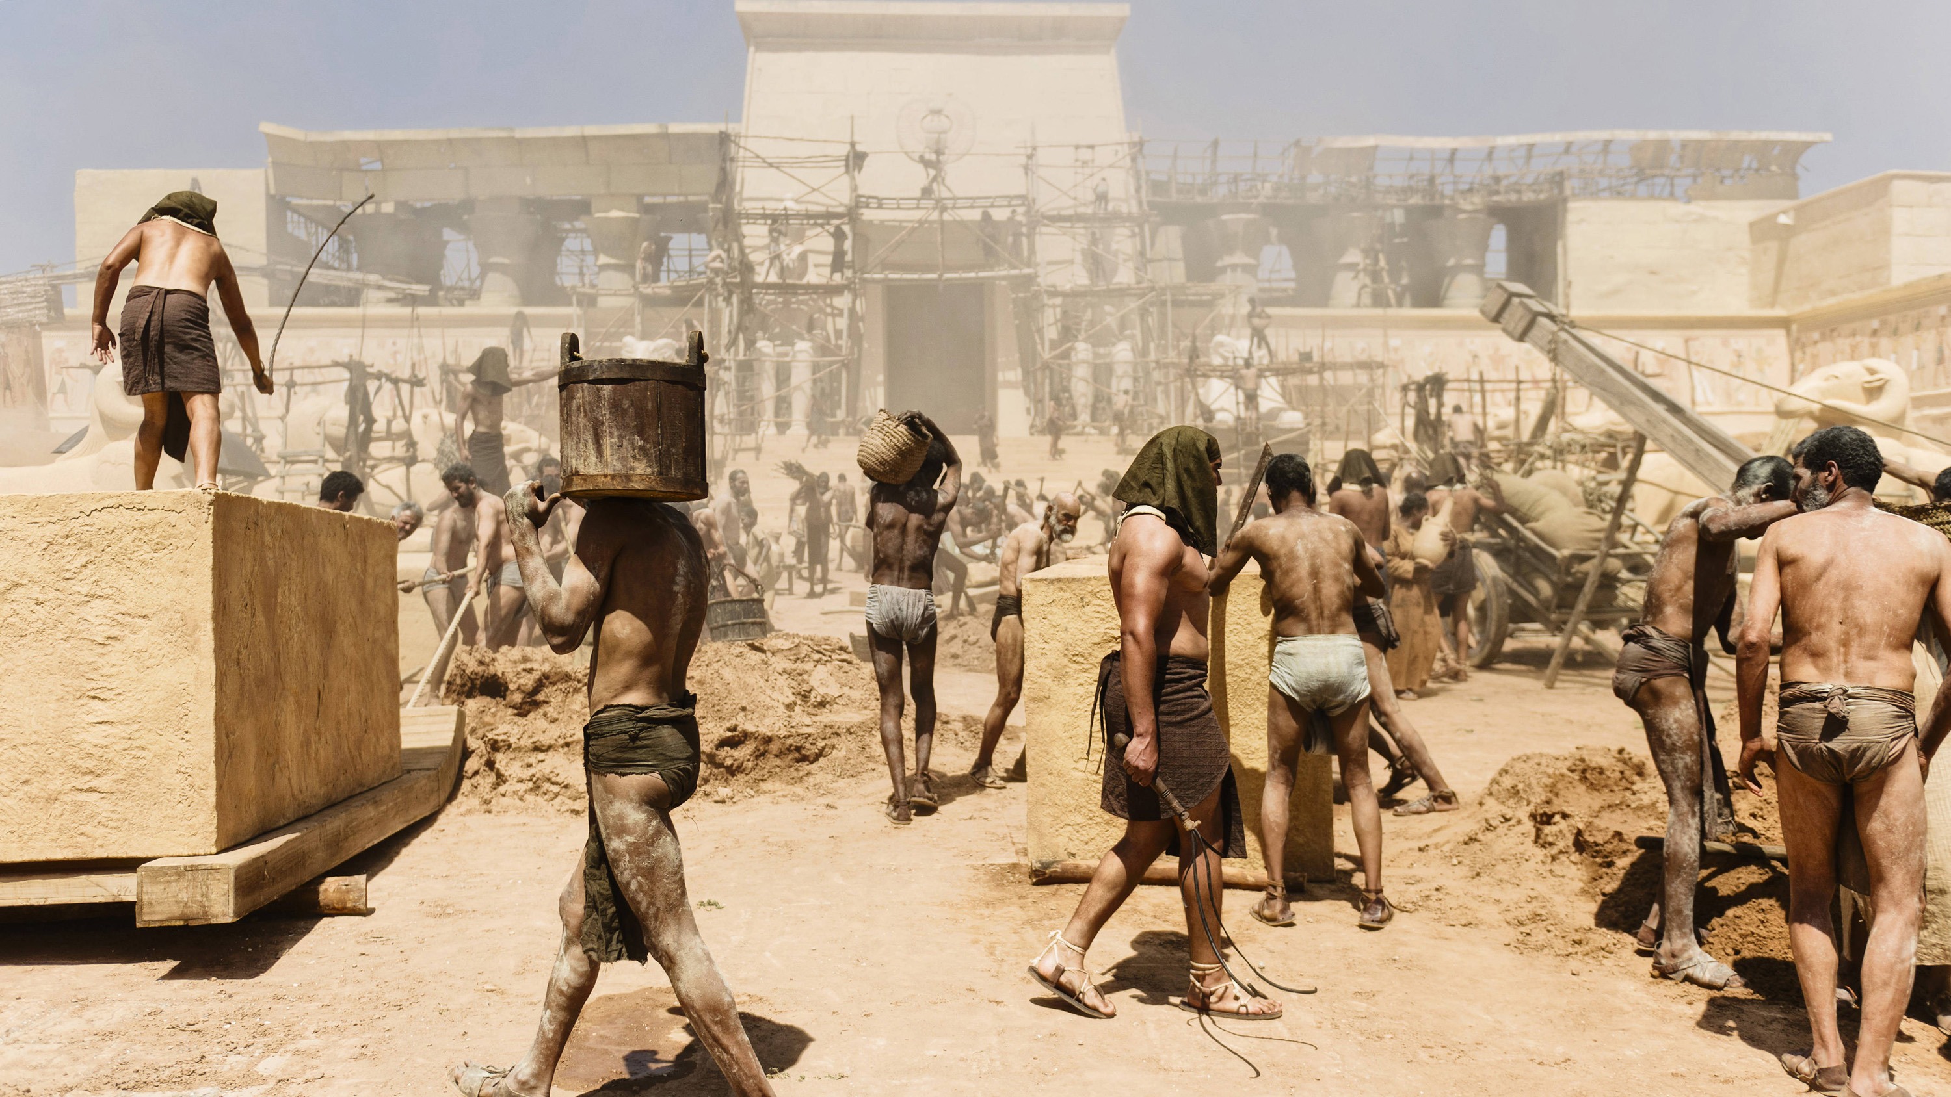
Can we switch off, or are we like the Hebrew slaves in Egypt?

Slide 8
‘So God created man in His own image; in the image of God He created him; male and female He created them…
…And God said, "See, I have given you every herb that yields seed which is on the face of all the earth, and every tree whose fruit yields seed; to you it shall be for food…
…Then God saw everything that He had made, and indeed it was very good. So the evening and the morning were the sixth day…
…Then God blessed the seventh day and sanctified it, because in it He rested from all His work which God had created and made…
...And the LORD God formed man of the dust of the ground, and breathed into his nostrils the breath of life; and man became a living being. The LORD God planted a garden eastward in Eden, and there He put the man whom He had formed…
…Then the LORD God took the man and put him in the garden of Eden to tend and keep it. (Gen. 1:27-2:15 NKJ)

Slide 9
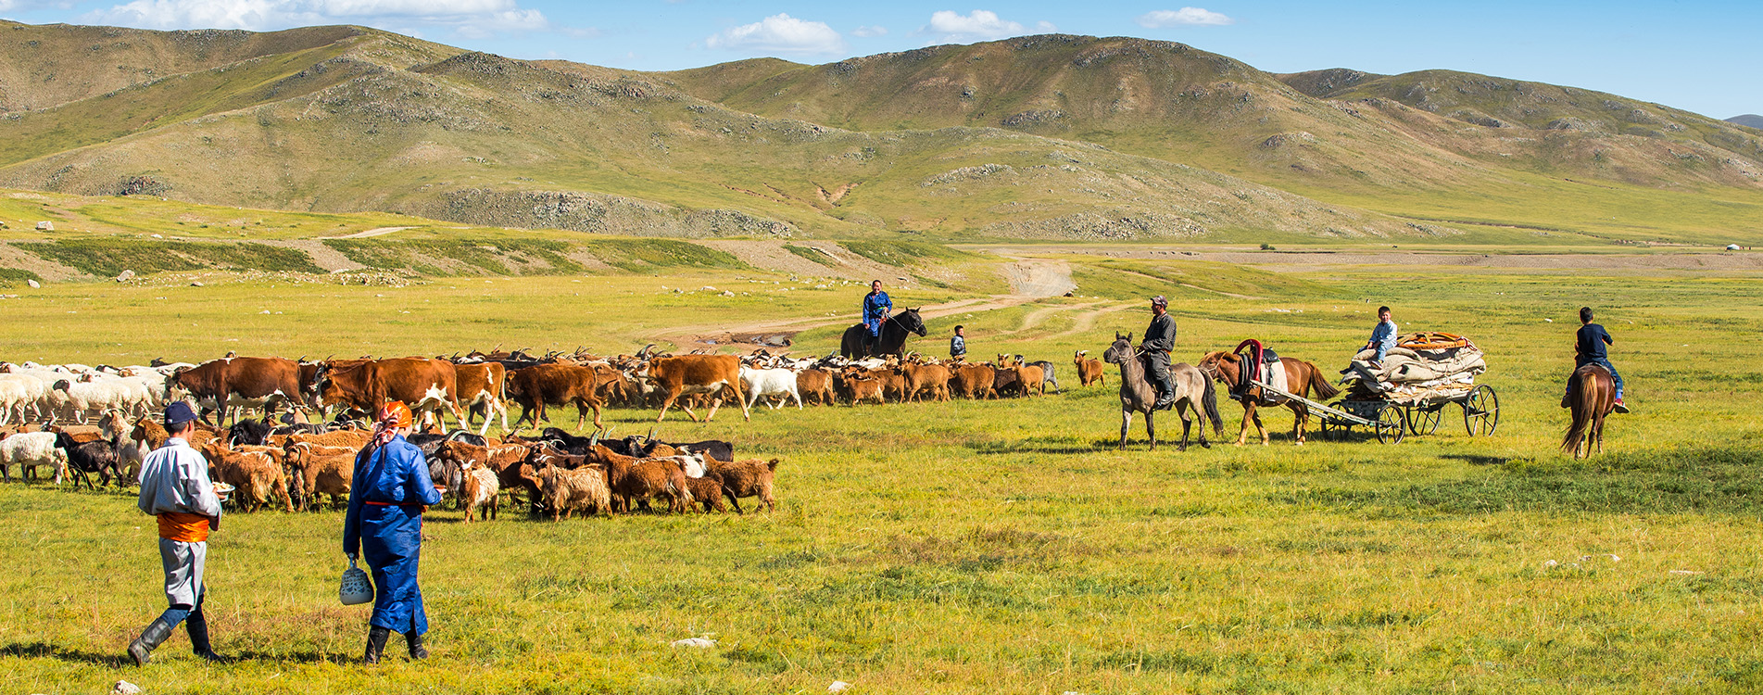
Nomads in Mongolia
More than 50% of population moved to the capital about a decade ago

Slide 10
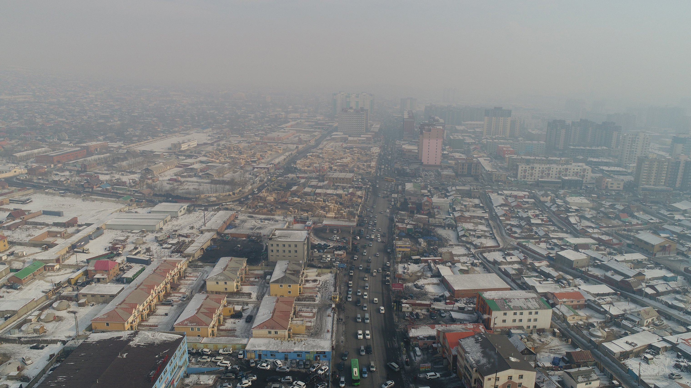
The most polluted capital in the world (since 2010) - Ulan Bator

Slide 11
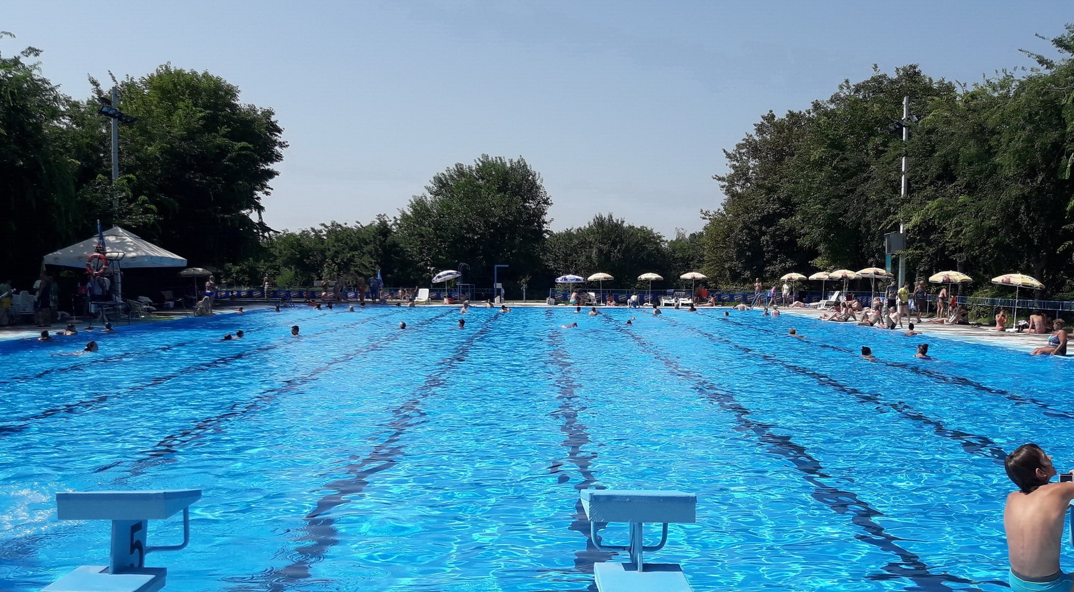
Fast food since about 2010

Slide 12
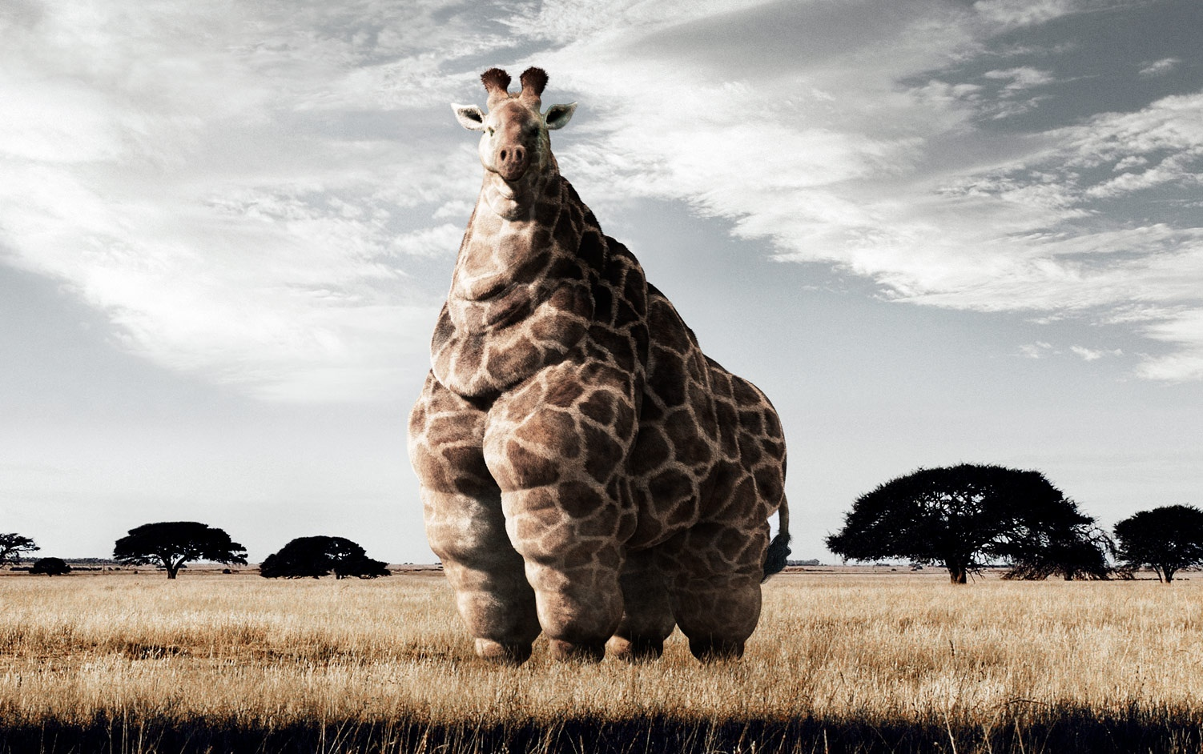
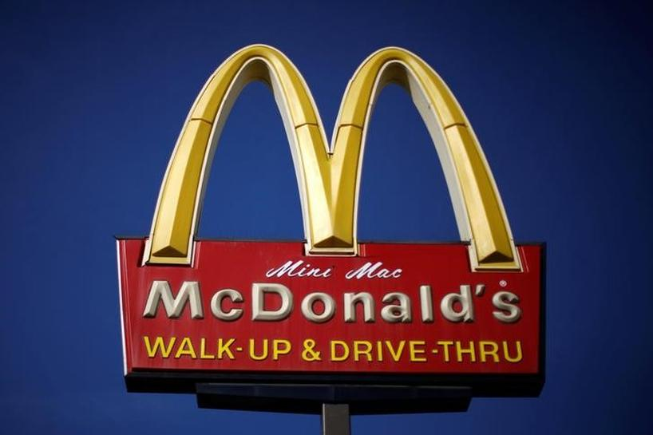

Slide 13
The very first processed ‘fast food’ 1870
Grinding stones replaced by steel rollers

Slide 15
‘So God created man in His own image; in the image of God He created him; male and female He created them…
…And God said, "See, I have given you every herb that yields seed which is on the face of all the earth, and every tree whose fruit yields seed; to you it shall be for food…
…Then God saw everything that He had made, and indeed it was very good. So the evening and the morning were the sixth day…
…Then God blessed the seventh day and sanctified it, because in it He rested from all His work which God had created and made…
...And the LORD God formed man of the dust of the ground, and breathed into his nostrils the breath of life; and man became a living being. The LORD God planted a garden eastward in Eden, and there He put the man whom He had formed…
…Then the LORD God took the man and put him in the garden of Eden to tend and keep it. (Gen. 1:27-2:15 NKJ)

Slide 16
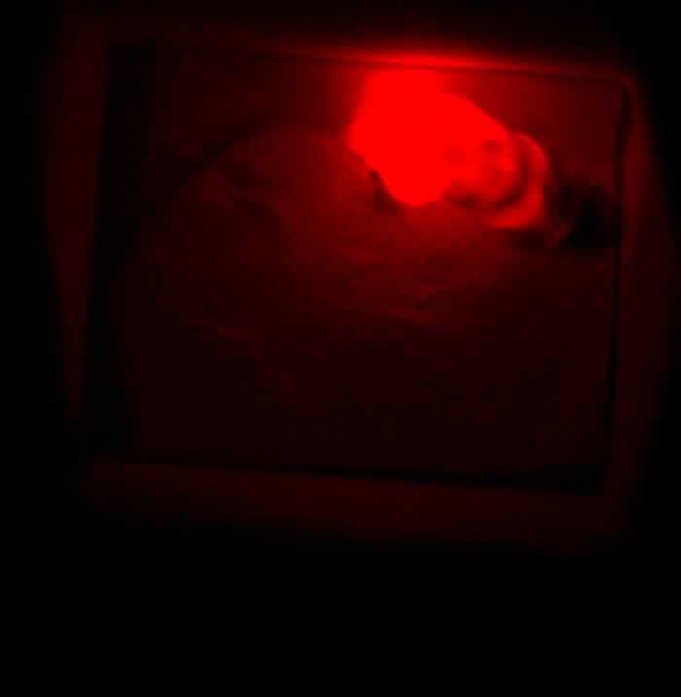
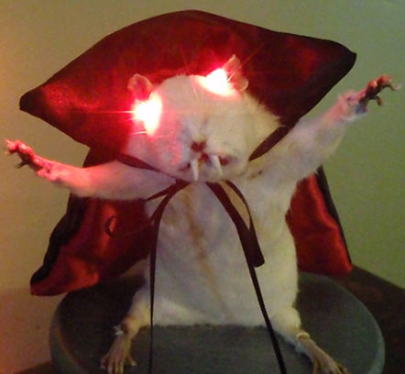
Modern artificial world improving on God’s original design
I LUCIFERIN

Slide 17
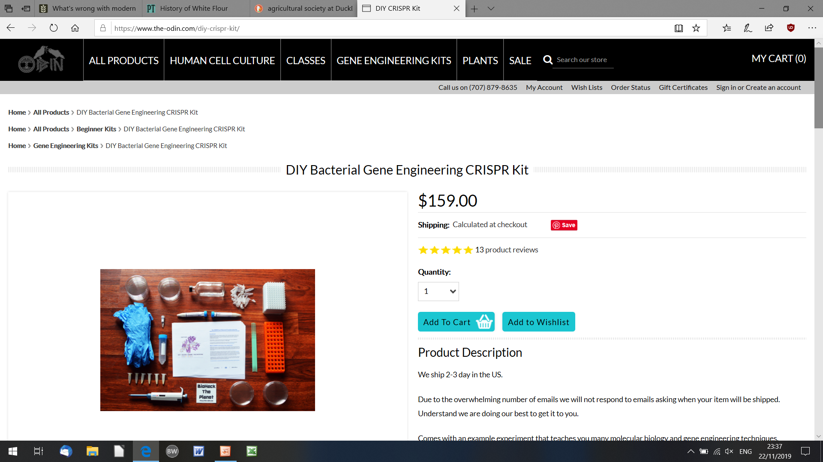

Slide 19
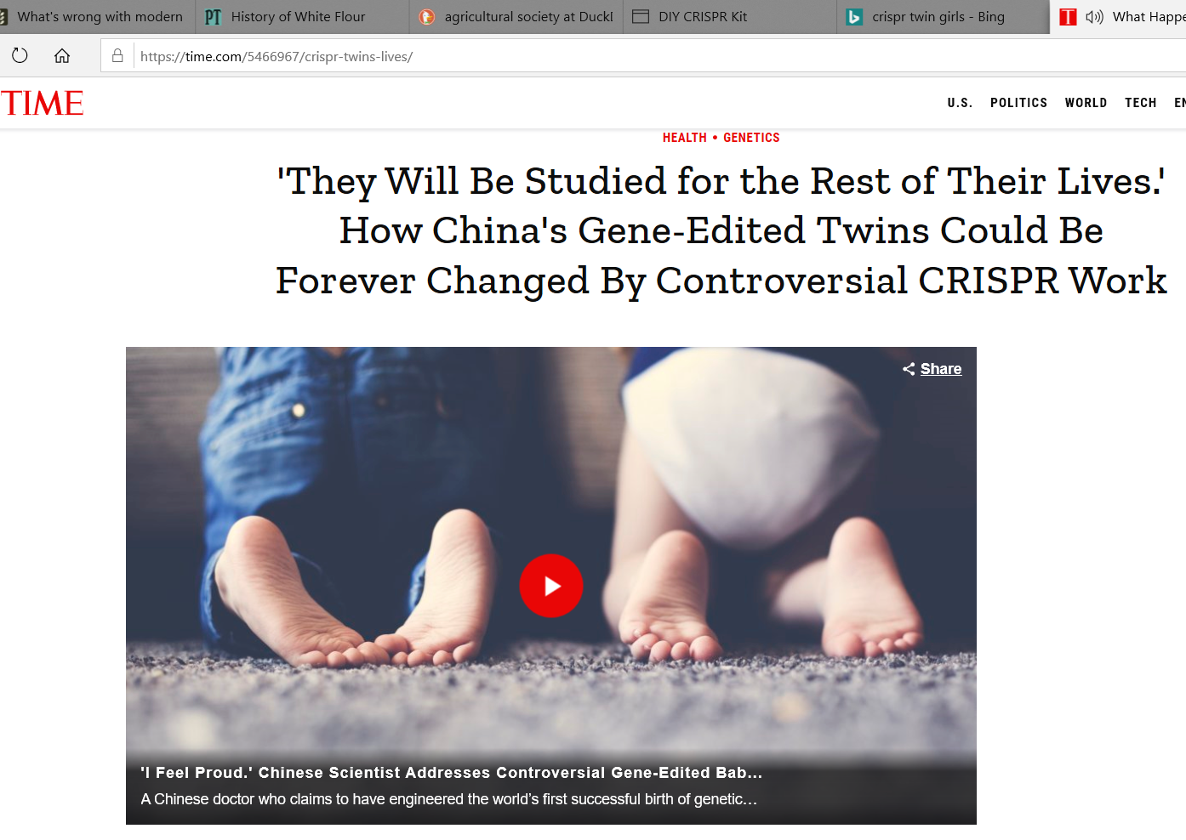

Slide 20
‘So God created man in His own image; in the image of God He created him; male and female He created them…
…And God said, "See, I have given you every herb that yields seed which is on the face of all the earth, and every tree whose fruit yields seed; to you it shall be for food…
…Then God saw everything that He had made, and indeed it was very good. So the evening and the morning were the sixth day…
…Then God blessed the seventh day and sanctified it, because in it He rested from all His work which God had created and made…
...And the LORD God formed man of the dust of the ground, and breathed into his nostrils the breath of life; and man became a living being. The LORD God planted a garden eastward in Eden, and there He put the man whom He had formed…
…Then the LORD God took the man and put him in the garden of Eden to tend and keep it. (Gen. 1:27-2:15 NKJ)

Slide 21
Alternatives improving on God’s original design

Slide 22
‘So God created man in His own image; in the image of God He created him; male and female He created them…
…And God said, "See, I have given you every herb that yields seed which is on the face of all the earth, and every tree whose fruit yields seed; to you it shall be for food…
…Then God saw everything that He had made, and indeed it was very good. So the evening and the morning were the sixth day…
…Then God blessed the seventh day and sanctified it, because in it He rested from all His work which God had created and made…
...And the LORD God formed man of the dust of the ground, and breathed into his nostrils the breath of life; and man became a living being. The LORD God planted a garden eastward in Eden, and there He put the man whom He had formed…
…Then the LORD God took the man and put him in the garden of Eden to tend and keep it. (Gen. 1:27-2:15 NKJ)

Slide 23
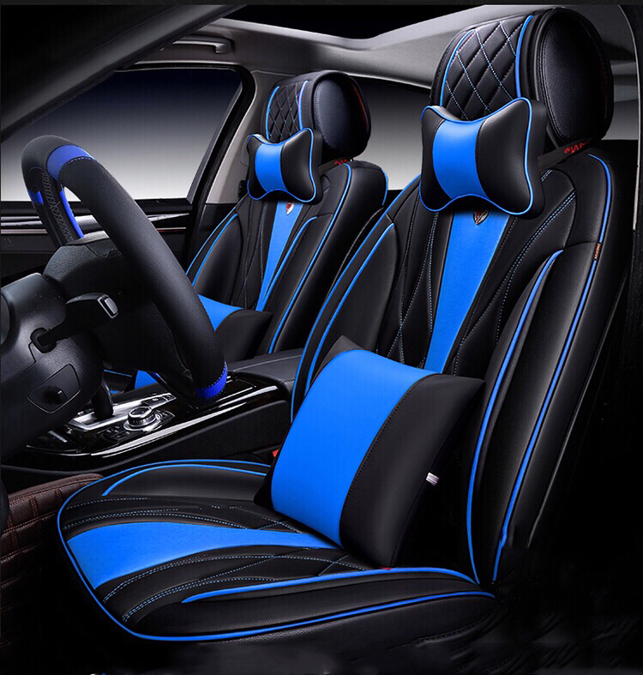

Slide 24
‘Then I saw another angel flying in the midst of heaven, having the everlasting gospel to preach to those who dwell on the earth-- to every nation, tribe, tongue, and people saying with a loud voice,
"Fear God and give glory to Him, for the hour of His judgment has come; and worship Him who made heaven and earth, the sea and springs of water.’ (Rev. 14:6-7 NKJ)

